Slide 1
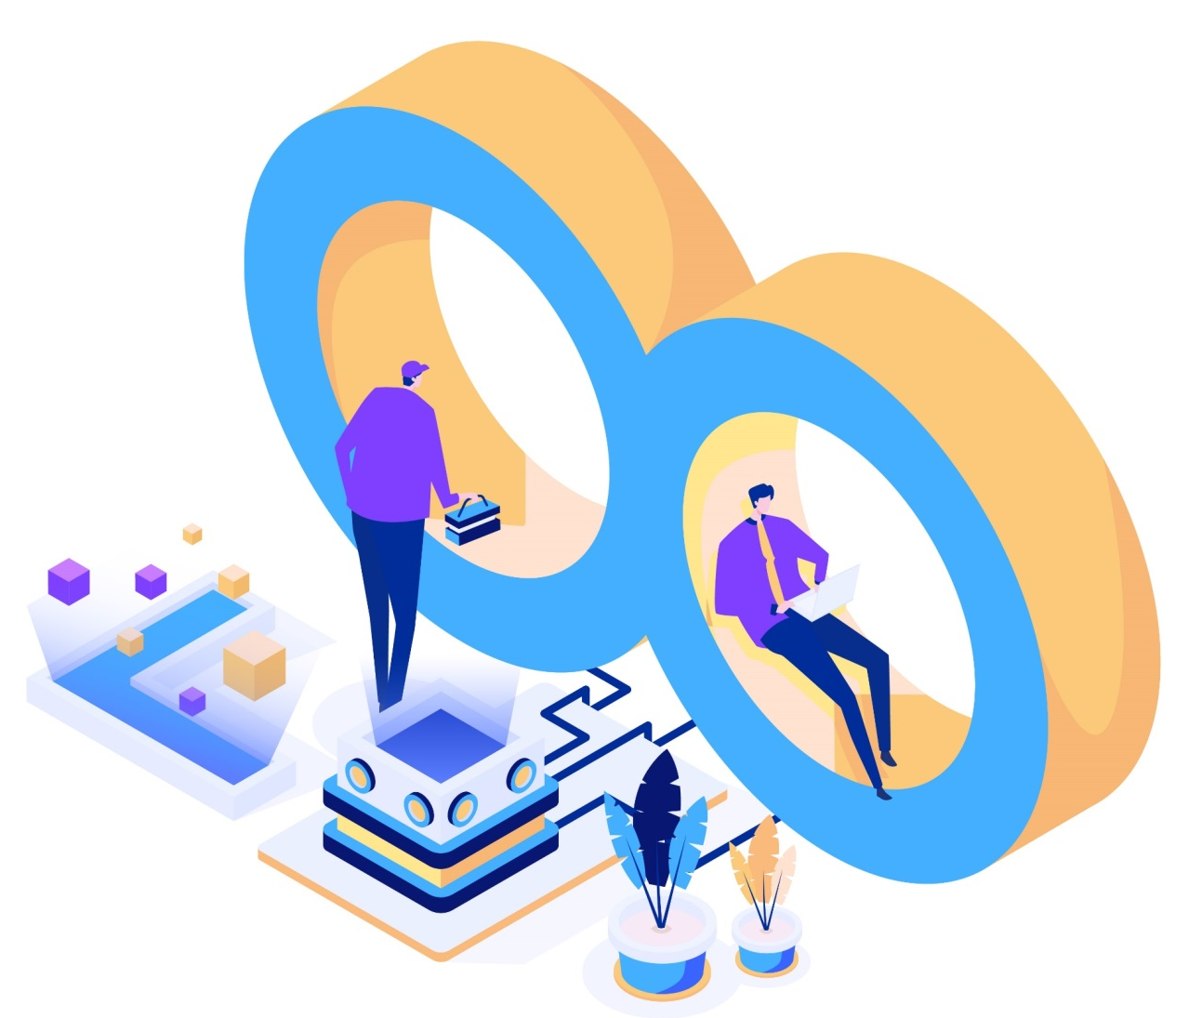
DevOps - The Infinite Loop
By
Abdul Hakeem

Slide 2
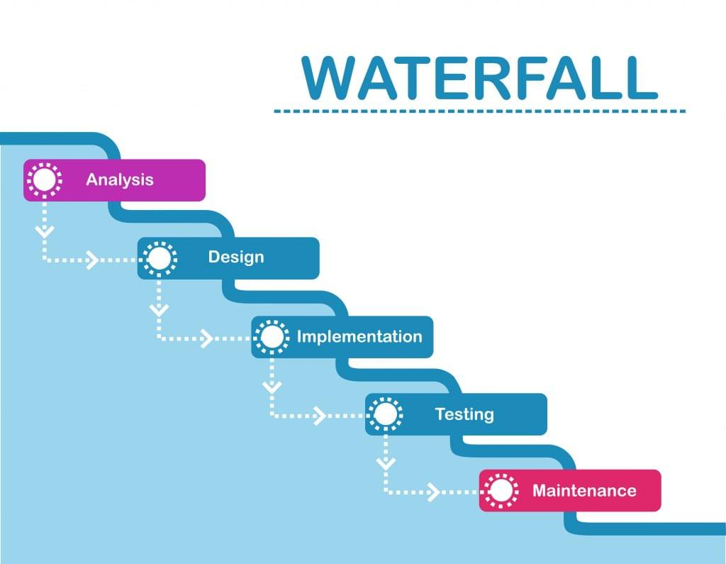
Software development lifecycle
Advantages:
Before the next phase of development, each phase must be completed
They should perform quality assurance test (Verification and Validation) before completing each stage
Elaborate documentation is done at every phase of the software’s development cycle
Suited for smaller projects where requirements are well defined
Disadvantages:
Error can be fixed only during the phase
It is not desirable for complex project where requirement changes frequently
Testing period comes quite late in the developmental process
Clients valuable feedback cannot be included with ongoing development phase
Small changes or errors that arise in the completed software may cause a lot of problems

Slide 3
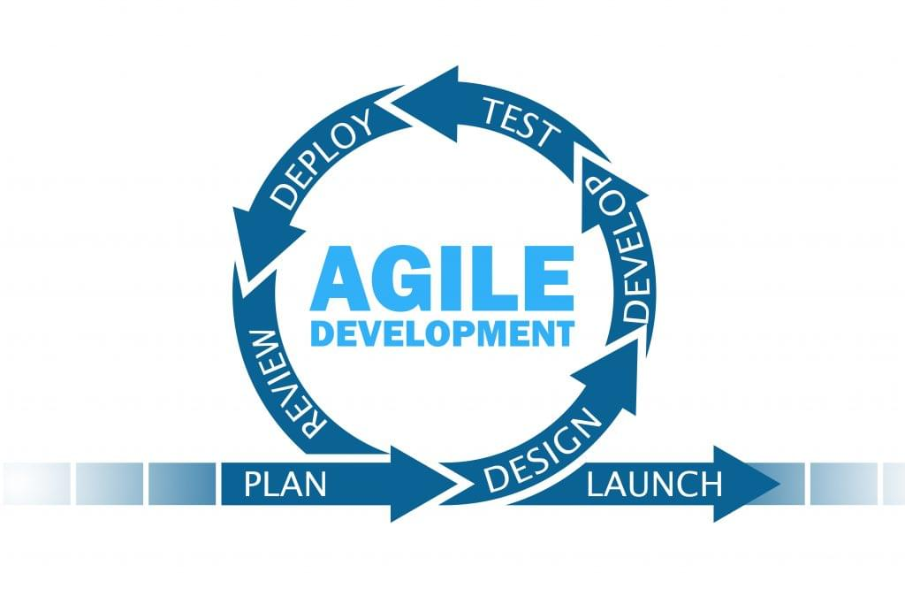
Agile:
Advantages:
In Agile methodology the daily interactions are required between the business people and the developers.In this methodology attention is paid to the good design of the product.
The customers are satisfied because after every Sprint working feature of the software is delivered to them.
Customers can have a look of the working feature which fulfilled their expectations.
Changes in the requirements are accepted even in the later stages of the development.
An Agile/Scrum approach can improve organizational synergy by breaking down organizational barriers and developing a spirit of trust and partnership around organizational goals.
Disadvantages:
Poor resource planning
Limited documentation
Difficult measurement
No finite end

Slide 4
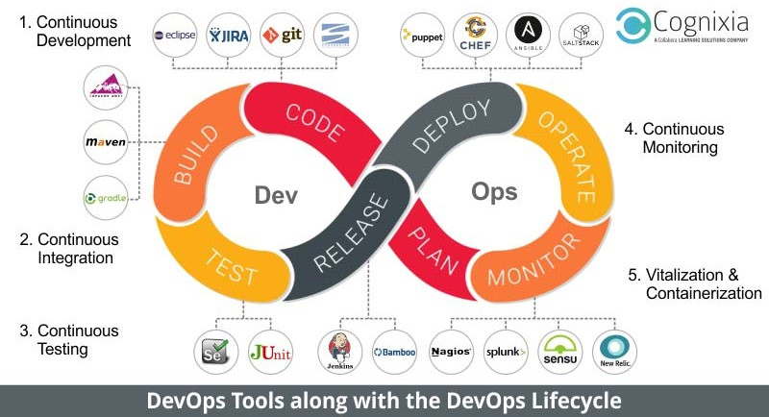
DevOps :

Slide 5
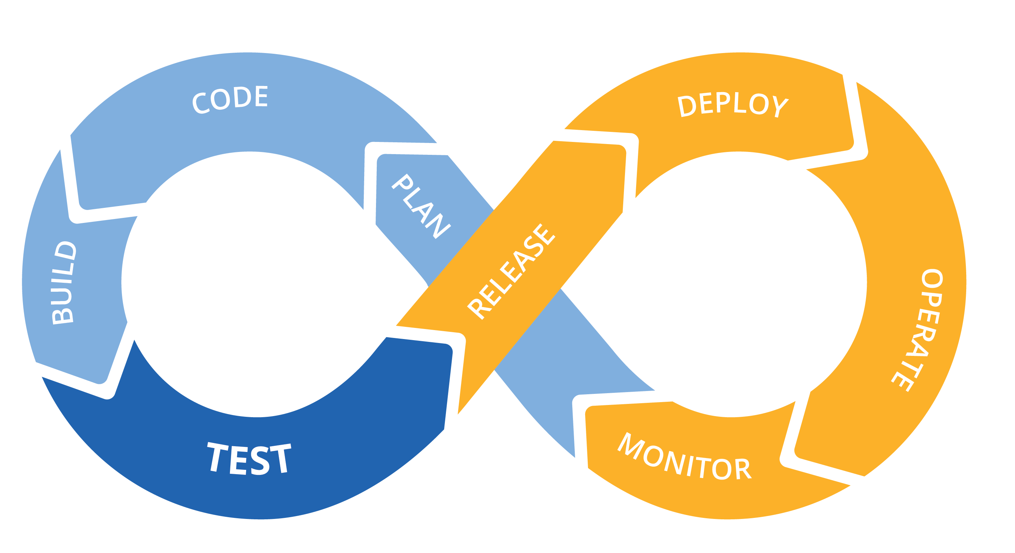
Introduction to DevOps
The idea behind DevOps is to demolish the wall between development and operations, and encourage more collaboration and accountability between both groups so that everyone feels responsible for the code no matter where it is in the software development lifecycle.
Tighter alignment between Development & Operations to increase application velocity with managed risk.

Slide 6
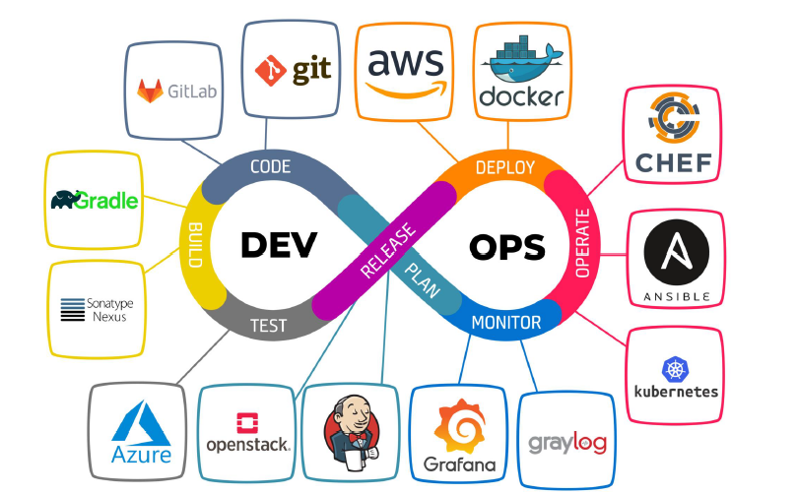

Slide 7
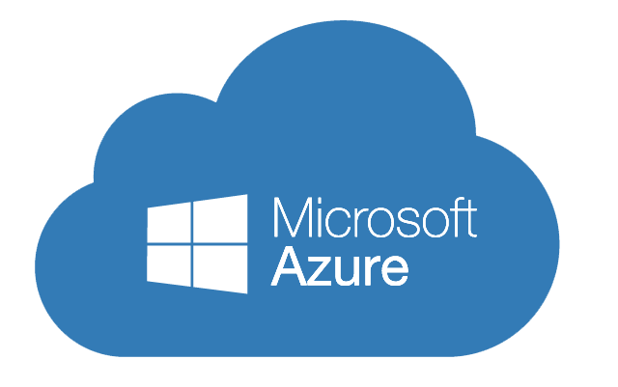
Introduction to azure
Azure, announced at Microsoft's Professional Developers Conference (PDC) in October 2008, went by the internal project codename "Project Red Dog”
formally released in February 2010 as Windows Azure, before being renamed Microsoft Azure on March 25, 2014.
Azure provides 260+ services.

Slide 8
What is Microsoft Azure?
Azure is a cloud computing platform which was launched by Microsoft in February 2010. It is an open and flexible cloud platform which helps in development, data storage, service hosting, and service management. The Azure tool hosts web applications over the internet with the help of Microsoft data centers.

Slide 9
What is Cloud Computing?
Cloud computing is a term referred to storing and accessing of data over the internet. It doesn’t store any data on the hard disk of your personal computer.
In cloud computing, you access data from a remote server.

Slide 10
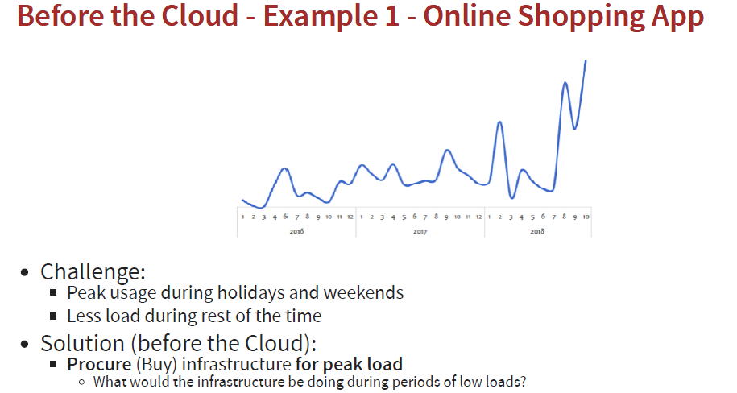

Slide 11
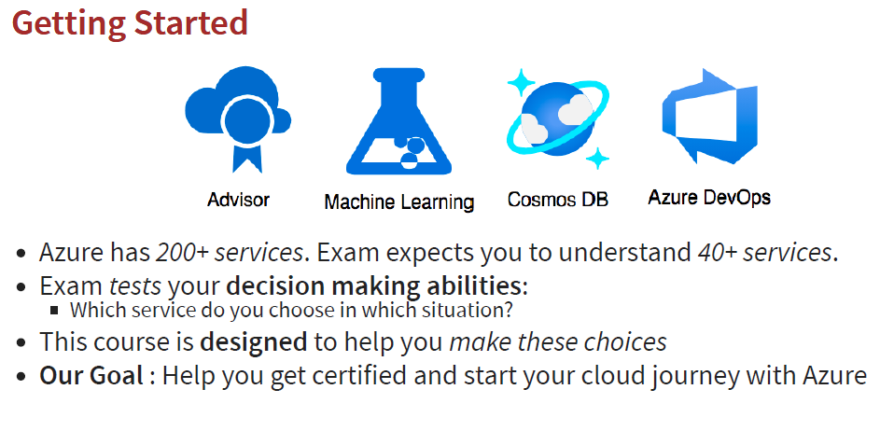

Slide 12
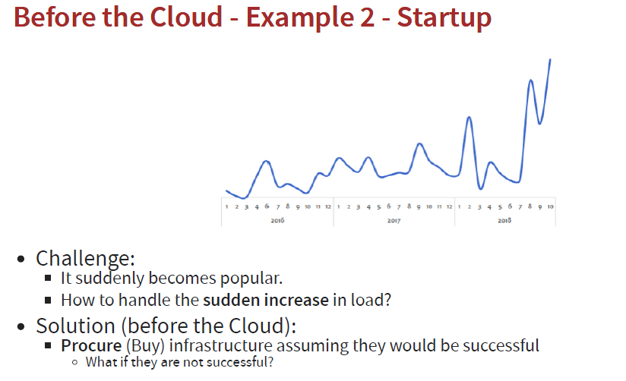

Slide 13
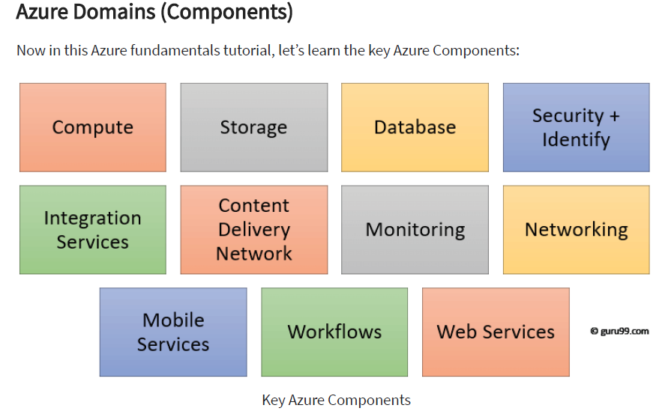

Slide 14
CLOUD DEPLOYMENT MODELS
PUBLIC CLOUD
There is no local hardware to manage or keep up-to-date in a public cloud – everything runs on your cloud provider’s hardware.
Advantages | Disadvantages
High scalability/agility | Security requirements that cannot be met by using public cloud
Pay-as-you-go pricing | Government policies, industry standards, or legal requirements which public clouds cannot meet
Not responsible for maintenance or updates of the hardware | You don’t own the hardware or services and cannot manage them as you may want to
Minimal technical knowledge to set up and use | Unique business requirements, such as having to maintain a legacy application might be hard to meet

Slide 15
PRIVATE CLOUD
In a private cloud, you create a cloud environment in your own datacenter and provide self-service access to compute resources to users in your organization. This offers a simulation of a public cloud to your users, but you remain completely responsible for the purchase and maintenance of the hardware and software services you provide.
Advantages | Disadvantages
You can ensure the configuration can support any scenario or legacy application | You have some initial CapEx costs and must purchase the hardware for startup and maintenance
You can control (and responsibility) over security | Owning the equipment limits the agility - to scale you must buy, install, and setup new hardware
Private clouds can meet strict security, compliance, or legal requirements | Private clouds require IT skills and expertise that’s hard to come by
Economies at scale and integration with Azure Security Center

Slide 16
HYBRID CLOUD
A hybrid cloud combines public and private clouds, allowing you to run your applications in the most appropriate location.
Advantages | Disadvantages
Keep any systems running and accessible that use out-of-date hardware or an out-of-date operating system | Can be more expensive than selecting one deployment model since it involves some CapEx cost up front
You have flexibility with what you run locally versus in the cloud | It can be more complicated to set up and manage
You can take advantage of economies of scale from public cloud providers for services and resources where it’s cheaper, and then supplement with your own equipment when it’s not
You can use your own equipment to meet security, compliance, or legacy scenarios where you need to completely control the environment

Slide 17
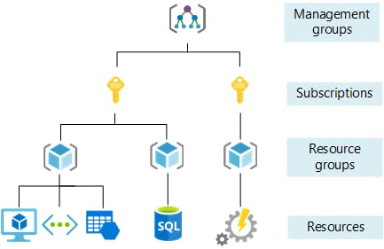
Azure Resource manager ARM

Slide 18
Managed services
IAAS
PAAS
SAAS

Slide 19
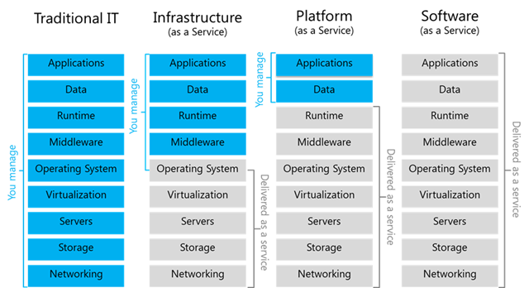
IAAS PASS SASS

Slide 20
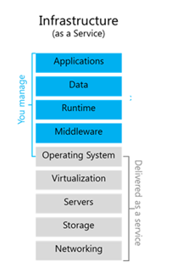
IAAS (Infrastructure As a service)
Infrastructure as a Service (IaaS) in Azure provides virtualized computing resources over the internet.
It allows users to rent virtual machines, storage, and networking infrastructure on a pay-as-you-go basis.
With IaaS, organizations can avoid the cost and complexity of owning and maintaining physical servers and data centers.
Ex: virtual machines

Slide 21
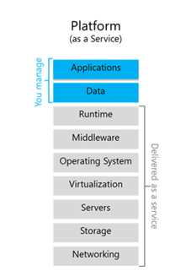
PAAS (Platform As a service)
Platform as a Service (PaaS) in Azure is a cloud computing service that provides a platform allowing customers to develop, run, and manage applications without dealing with the complexities of infrastructure management.
Ex: App service(webapp,function app), Storage account,AKS, SQL, Cosmos, Azure Devops

Slide 22
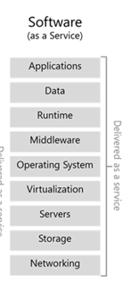
SAAS (Software As a service)
Software as a Service (SaaS) in Azure refers to cloud-based applications that are delivered and accessed over the internet.
In the context of Azure, SaaS offerings encompass a variety of software applications that are fully managed and hosted by Microsoft, allowing users to access the software without the need for installing, maintaining, or managing the underlying infrastructure.
EX: MS365,Dynamic, Azure AD

Slide 23
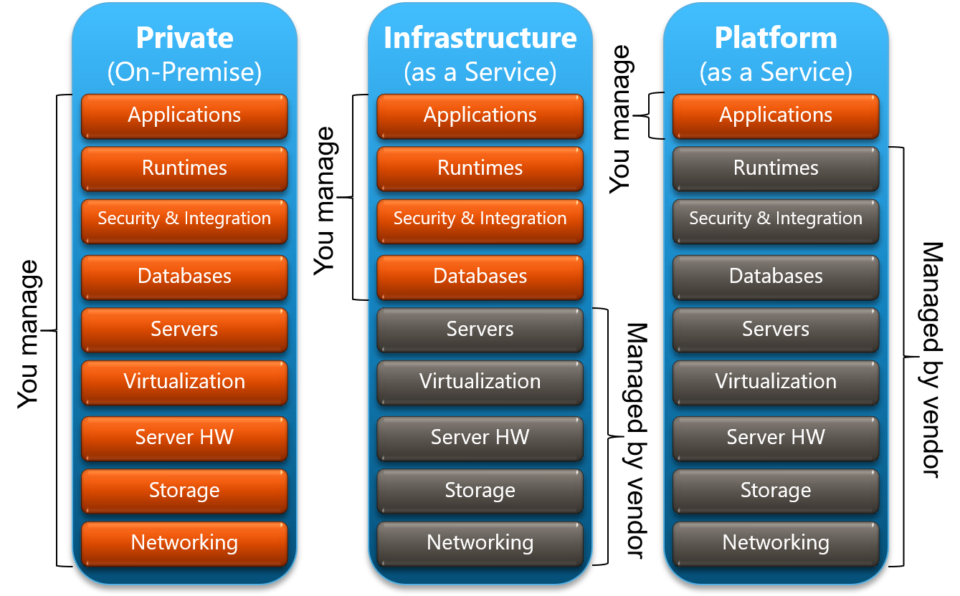

Slide 24
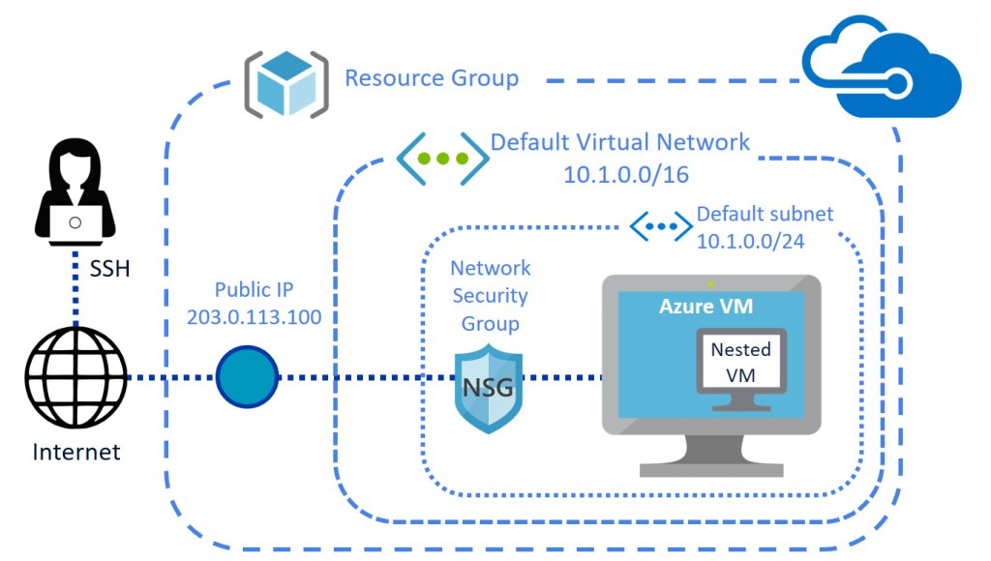

Slide 25
Advantages of Devops
Dis-advantages of Devops
Faster product release and faster time to market
Higher productivity, Process efficiency
Shortened production cycles, Better operational support
Engaged and motivated staff, Better Customer experience management
Clear product vision within the team
Increased deployment success rates, Increased product quality
Better team efficiency
Improved flexibility and support
Reduced chance of product failure
Cross-skilling and self-improvement
Demands proper mindset across the company
Lowered business security by outsourcing the DevOps operations
Dealing with the legacy system is a challenge
Practicing security for CI/CD is a separate affair
Getting the right pool of DevOps expertise is a challenge
Challenges with the number of tools and switching tools
Transition challenges (organizational and technical)

Slide 26
What is Continuous Integration (CI)? • Continuous Integration is a practice that integrates code into a shared repository • It uses automated verifications for the early detection of problems • Continuous Integration doesn't eliminate bugs, but helps in finding and removing them easily
What is Continuous Delivery (CD)? • When both these practices are placed in order, all the steps could be referred to as automated, and this process is CI/CD • Implementation of CI/CD enables the team to deploy codes quickly and efficiently • The process makes the team more agile, productive, and confident • Continuous Delivery is the phase in which the changes are made in the code before deploying • The team in this phase decides what is to be deployed to the customers and when • The ultimate goal of the pipeline is to make deployments

Slide 27
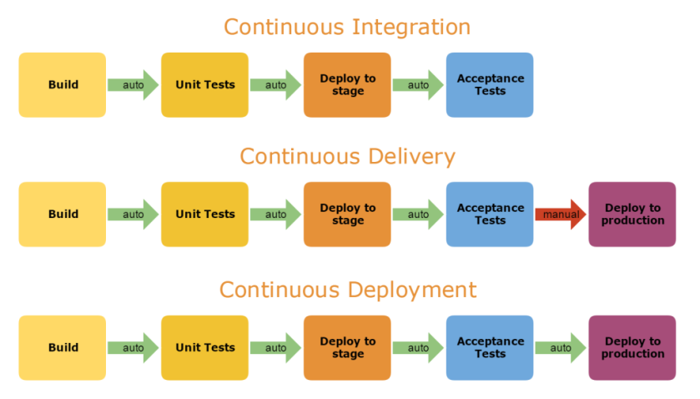

Slide 28
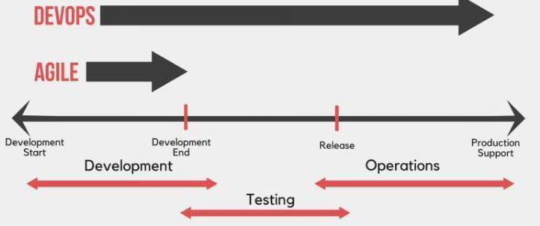
Understanding DevOps
you should consider the following points as well,
DevOps means only combining the two teams of Development and Operations.
It is not a separate team.
It is not a product or tool.
DevOps people do not hire from outside, they are internal team members who are working either in the development phase or in the operations phase.

Slide 29
PLAN
It is the first stage of any new project. Here, we plan for a new project from requirement gathering from the customer and planning, to delivering the final project to the customer. We find out,
What the requirements are.
What types of product we have to create.
What the timelines are for different sprints and the final product.
What technologies we will use.
What tools we will use.
How many team members will be available for this project.
What process we are going to follow, like Agile
CODE
In this stage, we do the coding for creating the product with actual functionality as discussed with the customer. We use different types of methodologies for achieving the goal, like Agile methodology. Here we group the tasks in the sprint and their time estimation as well. Sprints are basically for 2-3 weeks. Unit Test cases are also to be a part of the coding.
BUILD
In this stage, we build the code. Code building happens two times; first when a developer is writing the code, then he/she has to build the code every time in their own local system to see the functionality. The second time, when a team member checks in the code in the source control repository, then it automates the build for the code and makes the artifact for deployment.

Slide 30
TEST
Testing is the heart of any development process. We write the Unit Test cases along with code. In DevOps, test cases auto execute and validate the build process.
RELEASE
In this stage, it collects the build artifact which can deploy further.
DEPLOY
Here, we start the deployment on the respective stages which are configured in the Release Pipeline. Actually after testing and validating the build artifact, it auto starts the deployment on the respective environment using a continuous delivery process. But before deploying it to the production environment, it asks for approval which can be done manually.
We can also automate the whole deployment process using continuous deployment. This is basically used when we have small changes which can be deployed on production as well without any approvals.
OPERATE & MONITOR
After successful deployment on the production environment, we have to operate the whole system and monitor the application. This monitoring is not only the performance but also the functionality.

Slide 31
Azure DevOps Services
Azure Boards: Agile planning tools to track work with configurable Kanban boards, interactive backlogs, and powerful planning tools
Azure Pipelines: CI/CD for any platform. Build, test, and deploy in any language, to any cloud or on premises. Run in parallel on Linux, macOS, and Windows, and deploy containers to individual hosts or Kubernetes
Azure Repos: Unlimited, cloud-hosted private Git repos and collaborate to build better code with pull requests and advanced file management
Azure Test Plans: Test and ship with confidence using manual and exploratory testing tools
Azure Artifacts: Create, host, and share packages with your team, and add artifacts to your CI/CD pipelines with a single click

Slide 32
APACHE MAVEN
Maven is a widely used project object model-POM used in managing and building projects that are Java-based for Maven lifecycle management.
Maven Lifecycle
Maven Commands

Slide 33
1. Maven Lifecycle
The Maven build lifecycle has 8-stages by default. These are in a particular Maven lifecycle order, as mentioned below.
default site clean
Validation
Compilation
Testing
Packaging
Integration testing
Verification
Installation
Deployment.

Slide 34
Validation Phase:
Here, one ensures that the correct Maven lifecycle project structure is validated. Ex: In this step, the local repository is checked to ensure all dependencies are available and downloaded.
Compilation Phase:
In this phase, Maven is used with the source code for compilation wherein the java .files are converted to .class files and then stored in the classes/ target folder as classes.
Testing Phase:
Here, Maven runs all project unit tests for a Maven lifecycle.
Packaging Phase:
In this phase, the code is compiled into formats like WAR, JAR, etc., ensuring a distributable compiled code formatting.
Integration Testing Phase:
Maven is responsible for this phase to run the project’s integration tests.
Verification Phase:
This phase ensures that the Maven lifecycle project meets the required quality levels and that the project has been validated.
Installation Phase:
The local repository of a Maven lifecycle is then subject to the installation of the packaged code.
Deployment Phase:
In this phase, the packaged code is copied and deployed to other remote repositories where developers can share the compiled code.

Slide 35
2. Maven Commands
Maven interview questions which are a favorite with interviewers looking to quiz developers on knowledge of Maven are questions about the Maven commands discussed below.
mvn compile:
This command is used to compile the project’s source code.
mvn clean:
Here, the project is cleaned to remove all previous-build files generated.
mvn test:
With this command, one can run project testing steps.
mvn test-compile:
This command is used to compile the code from the test source.
mvn install:
This command helps deploys the packaged WAR/JAR files storing them as classes in the local repository.
mvn package:
With this Maven lifecycle command, one packages or creates a project WAR or JAR file to be able to use a distributable format.
mvn deploy:
The deploy command occurs after compilation, running project tests, and project building. Here the packaged WAR/JAR files are copied to the remote repository for use by other developers.

